Slide 1

Churn Analysis

Slide 2



Outline
1
2
3
4
What is Churn Analysis
How does it work
Real life examples
Churn Prediction

Slide 3
What is Churn Analysis
1

Slide 4
What is Churn Analysis
Companies use churn analytics to measure the rate at which customers quit the product, site, or service. It answers the questions “Are we losing customers?” and “If so, how?” to allow teams to take action.
Lower churn rates lead to happier customers, larger margins, and higher profits. To prevent churn, teams must first measure it with analytics.

Slide 5
Why does it matter
Prevent revenue loss
Lower customer acquisition costs
Reduce marketing and sales costs
Improve quality of customer service
Increase opportunity for up-sell and cross-sell

Slide 6
How does it work
2

Slide 7
How does it work
Churn analytics is a software that explains why churn occurs. They integrate into a company’s existing CRM and support systems to measure the loss of customers. Most churn analytics track individual user events to reveal the user’s journey—the steps users took before they quit—and allow teams to compare this behavior with that of retained customers to reveal what went wrong. There are three types of churn companies can measure: Subscription churn: Companies that charge a recurring fee define churn as the point at which a customer cancels or suspends the subscription. For example, when a customer calls to end their subscription to a news site, SaaS product, or fitness app. How to measure subscription churn:
# of customers that quit / total # of customers over a time period

Slide 8
How does it work
Non-subscription churn: Non-subscription churn is trickier to measure than subscription churn. E- commerce companies and ad-supported news sites rely on a steady stream of recurring visitors and define churn as the percentage of those visitors who don’t return for a period of weeks or months. In the non-subscription model, there’s lots of what’s known as rotational churn, where visitors who were considered churned return and no longer count as churned. How to measure non-subscription churn:
% of customers that have dropped below the threshold and are considered inactive, within a time period

Slide 9
How does it work
Revenue churn: Measures the percentage or dollar-value of revenue that’s churned over a time period. This is a common measure for SaaS companies. How to measure revenue churn:
$ of recurring revenue lost / total $ of recurring revenue at start of period

Slide 10
Industry example
3

Slide 11

Examples
Financial services: Measure account holder lifecycle, detect users thinking of switching banks
Consumer packaged goods: Develop a support model that
encourages loyalty
Consumer tech: Measure app churn
Energy: Measure how much revenue is at risk of being lost to other providers
Healthcare: Calculate the value of patients lost to other
providers
Insurance: Predict a user’s likelihood to close a policy
Life sciences: Measure churn for device or equipment buyers
Manufacturing: Measure churn for direct and downstream
buyers
Media and entertainment: Measure subscriber churn
Retail and e-commerce: Predict when shoppers pose a high churn risk
Telecommunications: Detect when customers are shopping
other carriers
Churn analysis is useful to any business with many customers, or to businesses with few, high-value customers. Which is to say, nearly every company. Companies in different industries use customer churn analytics for a variety of reasons:
Travel: Measure churn among repeat web visitors
page 11

Slide 12

Churn Prediction
4
Copyright @ Data Application Lab

Slide 13
Churn Prediction
Churn isn’t always straightforward to calculate, especially when it’s measured based upon past data. The future may resemble the past, but nothing is certain. Unforeseen events, from the emergence of new competitors to black swan market fluctuations, can prove old models wrong and lead companies to take the wrong actions. It’s also difficult for teams to apply the findings of churn analytics to individuals. While the the law of large numbers may prove churn statistics correct for an entire population, what does it mean when an individual presents a 20 percent chance of churn? What actions should the customer service agents take, if any? Finally, companies often apply customer churn analytics to too limited a dataset, such as only reviewing the last touch customers had with the company, which rarely tells the fully story. A customer that calls a support number to cancel their subscription isn’t canceling because they called support— they’re calling because they’ve accumulated grievances over many months. The call is merely a symptom. Teams that want to get to the bottom of their customers’ churn must view the entire customer journey, plot the low and high points, and determine its true cause. When selecting a churn analytics tool, consider:
Does it integrate with the company’s CRM and customer support system?
Does it offer one central repository for customer data?
Does it feature an interface
simple enough for non- experts to access?

Slide 14
Proactive retention with churn analytics
To prevent churn, teams must identify it. Teams can use a churn analytics tool to view the actions users took throughout their lifespan and develop hypotheses for what led them to quit. Follow-up surveys and questionnaires can provide critical details and suggest actions teams could have taken to prevent the churn. Teams can segment their churn data for greater clarity. No two customers quit for precisely the same reason, but classes of users, known as cohorts, often behave similarly. For example, users that signed up for a SaaS tool during a particular conference where they heard the CEO speak could have all shared a sense of awe that wore off after a few weeks, at which point they churned en-masse. Or a group of political campaigns could have adopted the tool for the duration of an election, then summarily dumped it once the outcome was decided. Not all churn is bad. Sometimes unprofitable or uncooperative users churn, and that’s good. Segmentation can help teams discover which customers are most valuable and seek to retain them above others. It can also help teams consider whether the users they’d like to keep from churning can actually be retained. In the example of political campaigns, those customers expire after the election no matter what and the churn may be inevitable. Teams can also segment churned users by how long they were customers. Are new users churning at higher rates than medium or long-term users? Has something about the service changed to cause it? With data, teams can develop hypotheses that they can test to reduce churn.

Slide 15
Do something about churn
With a sense of the events that cause churn, teams can develop a model to predict it for segments of users or, ideally, for individuals, based on their demographics and behaviors. This is known as predictive churn analytics and it can explain whether, say, a particular zip code suggests that a user is a greater risk of churn. Some tools allow teams to score all customers based on their likelihood to churn, known as a churn score, to allow marketing and customer service teams to prioritize their time. Teams can test measures for reducing churn at key points in the customer journey. For instance, teams can A/B test:
New messaging
Selective discounts
Eliminating steps in the buyer journey
Assigning more support to at-risk accounts
All the while, teams should collect satisfaction data through surveys, chat widgets, and feedback buttons, and tie that data back to particular individuals or accounts.

Slide 16
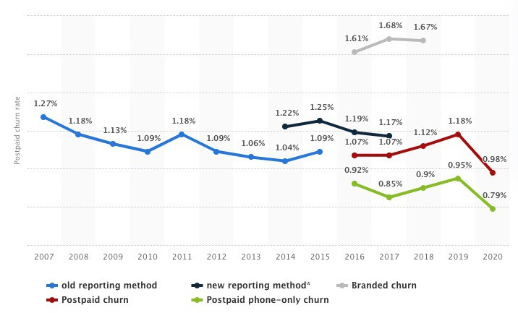
AT&T's wireless postpaid customer churn rate from 2007 to 2020

Slide 17
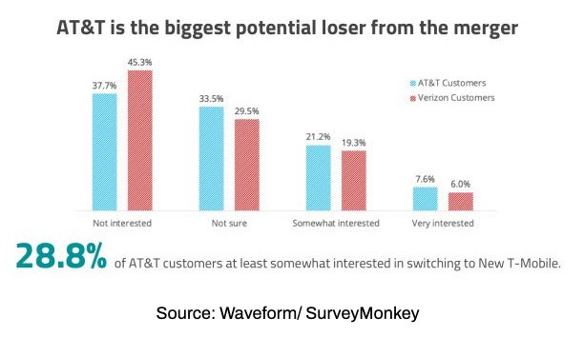
AT&T's wireless customer churn risk

Slide 18
Thank you

